Slide 1



IPL Win Prediction using Machine Learning
Name: DISHA GHOSH
Class: MCA , 2nd Year
Roll.No: 2306151031
Guided by: Dr. Manas Ranjan Senapati
Department: Computer Science and Engineering

Slide 2

Contents
1
Introduction to IPL and the Need for Prediction
2
Overview of the Machine Learning Approach
3
Data Collection and Preprocessing
This section will provide a brief overview of the Project.
This section will discuss the key aspects of the machine learning approach used here.
This section will explain the process of gathering and preparing the data for use in the machine learning model.
4
Feature Engineering and Selection
Model Development and Training
Model Evaluation and Refinement
4
5
6
This section will discuss the process of creating and selecting relevant features for the model.
This section will cover the training process for the selected machine learning model.
This section will explain how the model's performance is evaluated and how it is refined to improve accuracy.
7
Results and Discussion
8
Conclusion
This section will present the results of the model’s
predictions and discuss their significance.
This section will present conclusion that we will get.

Slide 3
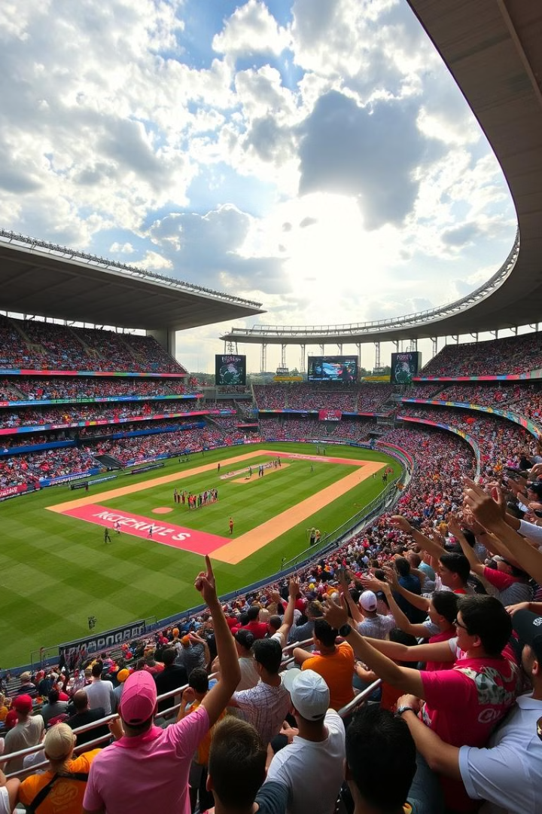

Introduction to IPL and the Need for Prediction
The Indian Premier League (IPL) is a professional Twenty20 cricket league in India. It is a highly competitive tournament featuring Ten teams from across India. The IPL is a significant event for both cricket fans and the Indian economy. It draws millions of viewers globally, and the tournament has a major economic impact on India. Predicting the outcomes of IPL matches is of great interest to fans, broadcasters, and even team owners. Accurate predictions can help fans plan their viewing schedules, broadcasters optimize their coverage, and team owners make informed decisions regarding player acquisitions and team strategies.

Slide 4

Overview of the Machine Learning Approach
1
Data Collection
The first step in the machine learning approach is to collect historical data on IPL matches. This data includes information on batting team, Bowling team, city, and other relevant factors.
2
Data Preprocessing
The collected data is then preprocessed to clean and transform it into a format suitable for machine learning models. This involves handling missing values,
converting categorical data into numerical data, and choosing right attributes.
3
Feature Engineering
Feature engineering involves creating new features from existing data that can enhance the model's predictive power.
This step involves using domain expertise to extract meaningful features from the data.
4
Model Selection
The next step is to choose an appropriate machine learning model for predicting match outcomes. The choice of model depends on factors like the nature of the data and the desired level of accuracy.
5
Model Training
The chosen model is then trained on the preprocessed data to learn the patterns and relationships between the features and match outcomes. This training process involves adjusting the model's parameters to minimize the prediction error.
6
Model Evaluation
Once the model is trained, it is evaluated on a separate set of data to measure its performance and identify areas for improvement.
7
Model Deployment
The final step is to deploy the trained model to make predictions on new IPL match data. This allows for prediction of match outcomes based on the lnput information.

Slide 5
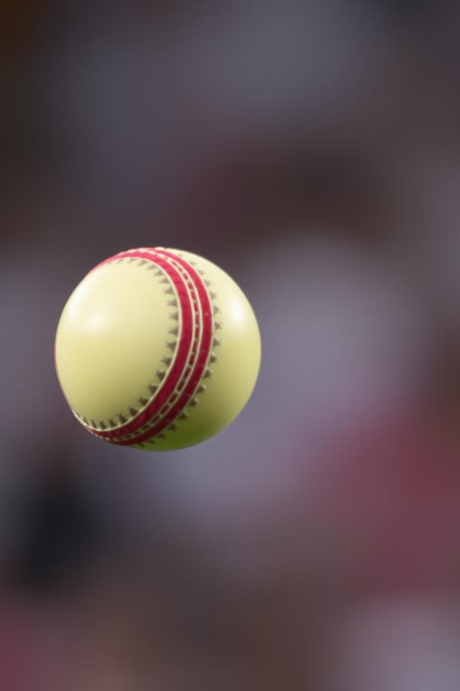
Objective
The objective of this project is to develop a machine learning model that can accurately predict the winner of an IPL match based on various factors such as batting team, Bowling team, city, and other relevant factors.. This model will be developed using historical data and machine learning algorithms, and it will be rigorously evaluated to ensure its accuracy and reliability.

Slide 6


Data Collection and Preprocessing
Data Sources
Data Cleaning
Feature Extraction
The data used in this project was collected from online platform kaggle. This websites provide comprehensive historical datasets on IPL matches. Here, We used two datasets and merged those datasets to create the Final dataset by choosing only the needed attributes for making prediction.
The collected data was then cleaned and preprocessed to ensure its accuracy and consistency. This involved removing duplicate entries, handling missing values, and converting data into the appropriate formats. For instance, categorical variables like team names were encoded into numerical values for the machine learning model to understand.
The preprocessed data was then used to extract relevant features that could influence the outcome of an IPL match. These features included factors such as target, balls left, runs left, total score, current score, and city.

Slide 7



Feature Engineering and Selection
Feature engineering is a crucial step in machine learning where new features are created or transformed from existing data. This process involves using domain expertise to extract meaningful features that can improve the model's prediction accuracy. In this IPL win prediction project, feature engineering involved creating features such as:
Feature Engineering:
Created derived features like Runs Left, Balls Left, Wickets Left, Current Run Rate (CRR), and Required Run Rate (RRR).
Encoded categorical variables (e.g., City, Teams) using techniques like one-hot encoding.
Applied feature scaling to normalize numerical data.
Feature Selection:
Conducted correlation analysis to identify relevant features.
Used model-based techniques like Random Forest and Recursive Feature Elimination (RFE) to rank and select impactful features.
Final features: City, Batting Team, Bowling Team, Target Score, CRR, and RRR.
This process improved model accuracy, reduced noise, and enhanced computational efficiency, making the predictions more reliable.

Slide 8
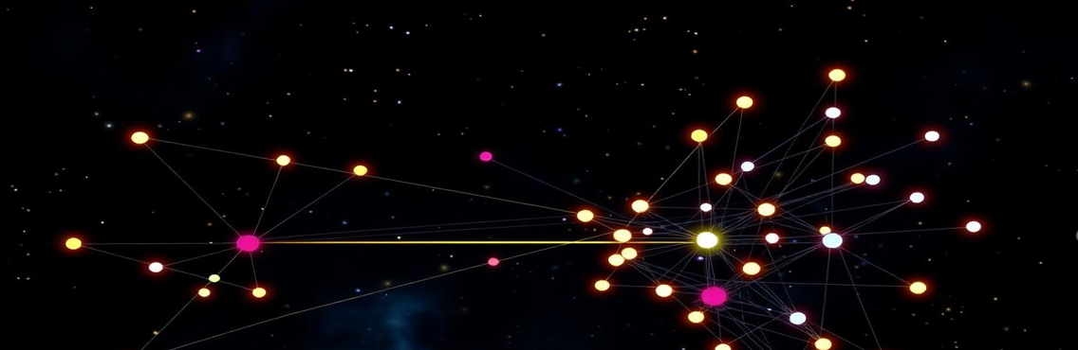


Model Development and Training
Several machine learning models were explored for this project, including Logistic Regression, and Random Forest. Each model was trained on the preprocessed data using a specific algorithm. The training process involved adjusting the model's parameters to minimize the prediction error. This involved feeding the model with training data and allowing it to learn the patterns and relationships between the features and the target variable, which was the outcome of the IPL match.

Slide 9
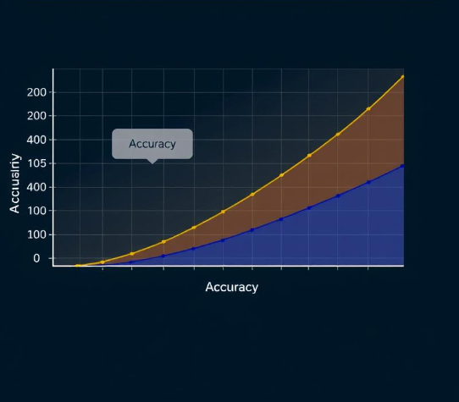

Model Evaluation and Refinement
Once the models were trained, they were evaluated on a separate set of data to assess their performance and identify areas for improvement. Various evaluation metrics were used, including accuracy, precision, recall, and F1-score. The evaluation results helped determine the best-performing model and identify areas for refinement. The model was then fine-tuned by adjusting its parameters and features to improve its accuracy and performance on the validation data.

Slide 10
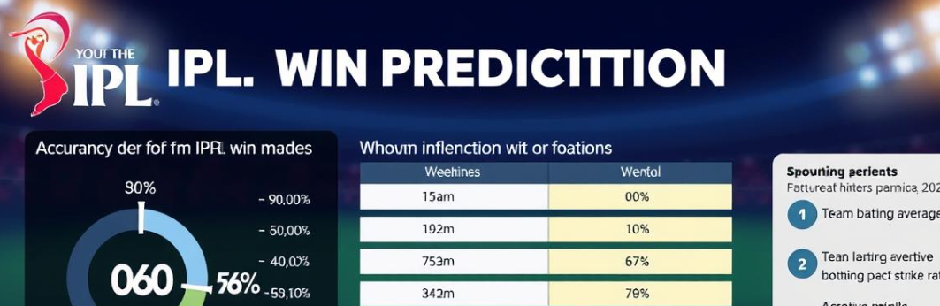


Result and Discussion
Model
Accuracy
Logistic Regression
82%
Random Forest
98%
The results of the model evaluation indicated that the Random Forest model achieved the highest accuracy of 98%. This suggests that the model is capable of predicting the winner of an IPL match with a high degree of confidence. The model's performance can be further improved by incorporating more data, refining the feature engineering process, and exploring more advanced machine learning algorithms. The insights generated by the model can be valuable for fans, broadcasters, and team owners, helping them make informed decisions and enhance their experience of the IPL.

Slide 11
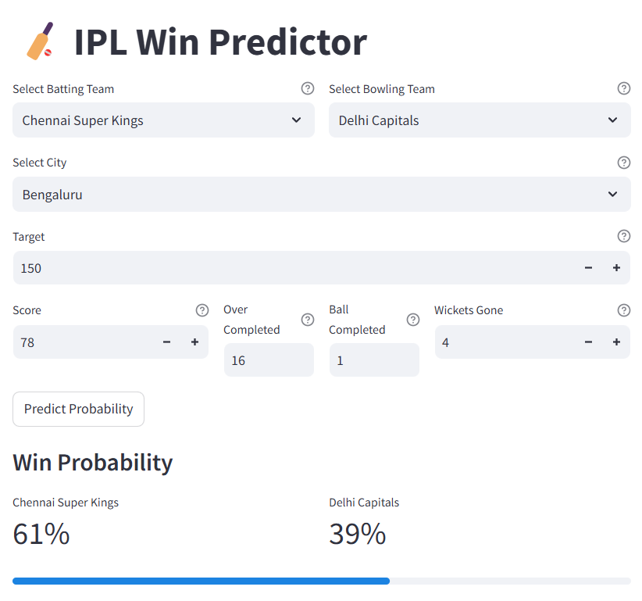
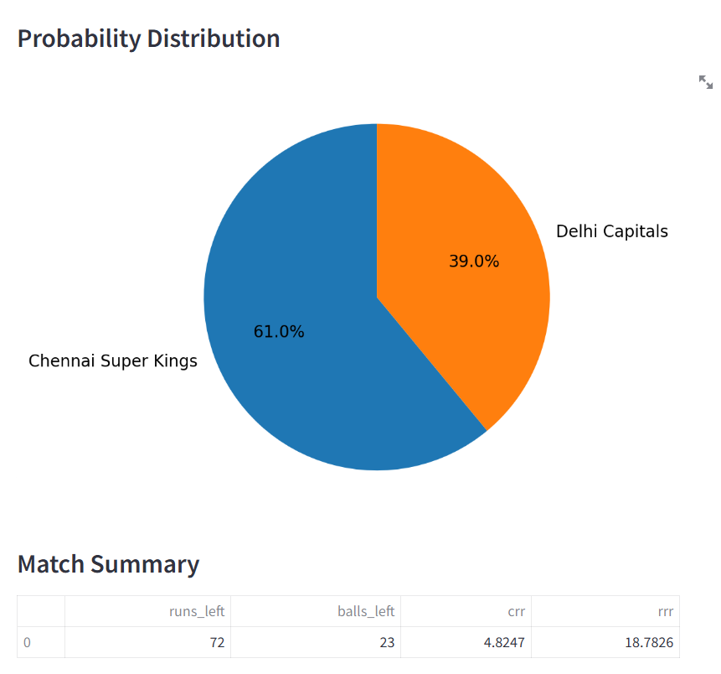



Sneak Peek

Slide 12



Conclusion
The IPL Win Prediction project successfully demonstrates the application of machine learning techniques in sports analytics. By leveraging historical match data, the model predicts the win probability of teams in real-time during an IPL match. Through rigorous feature engineering, selection, and model evaluation, the system integrates key factors like runs left, balls remaining, wickets in hand, and current and required run rates to deliver accurate and meaningful predictions. This project showcases the transformative potential of data-driven solutions in sports, enabling fans, analysts, and teams to gain deeper insights into match dynamics. Future improvements could involve incorporating advanced deep learning models and real-time streaming data for enhanced accuracy and adaptability.

Slide 13



Thank You!
We appreciate your time and interest in our IPL Win Prediction project.

